Slide 1
Used Cars Price Prediction
By Vivek Kumar

Slide 2
Problem Statement
To predict the price of used car based on the listed features.
Price is the most important factor when we look to purchase used cars. There are few others factors also which affect purchase decision.
In this project we will also try to find those factors.

Slide 3
Dataset
Total size : 50000 x 19
Unique Seller: 1 viz. Private
Unique Offer type: 2 viz. Offer, request
Unique Vehicle Type: 8 viz. Limousine, small car, station wagon, bus, cabrio, coupe, suv and others
Unique Gear Box: 2 viz. Manual and automatic
Unique abtest: 3 viz test and control
Unique fuel type: 7 viz. Petrol, diesel, lpg, cng, hybrid, electro and other
Unique postal code: 7050
Total listed model: 246
Total listed brand: 40
Minimum Price of any car: 0
Maximum Price of any car: 2147483647
Oldest car registration year: 1000
Newest car registration year: 9999
Least engine power (powerPS) of car: 0
Most engine power (powerPS) of car: 16312
Least distance travelled by any car: 5000
Most distance travelled by any car: 150000
Oldest ad time: 01/02/2016 0:00
Newest ad time: 31/03/2016 0:00

Slide 4
Preprocessing
Outliers Removal:
Year of Registration: limited to 1960 - 2019
Price: limited to 100 - 500000
PowerPS: limited to 10 - 50
Columns Removal:
seller: All values are private
offerType: Only 3 are request, rest other are offer
'name', 'dateCrawled', 'lastSeen', 'postalCode', 'dateCreated': These columns doesn’t contain any useful information
Missing Value Treatment:
Fill the missing values as NA
Label Encoder:
Columns containing category data are Label Encoded
Standard Scaler:
Entire dataset are scaled

Slide 5
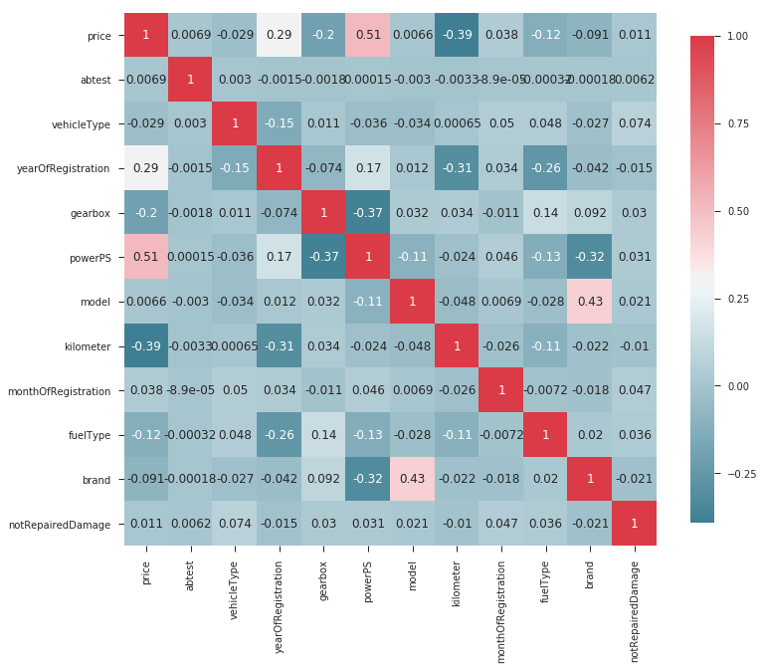
Correlation
Table: Correlation with Price
powerPS | 0.512137
kilometer | 0.392011
yearOfRegistration | 0.290437
gearbox | 0.200006
fuelType | 0.124232
brand | 0.090748
monthOfRegistration | 0.038303
vehicleType | 0.028916
notRepairedDamage | 0.010903
abtest | 0.006944
model | 0.006611
Figure: Correlation graph

Slide 6
Model
Dataset Preparation:
Input: Entire processed dataset except price column
Output: price
Dataset Splitting:
The dataset are splitted into training and testing set with 70 - 30 ratio respectively
Model Selection:
Random Forest Regressor
Training and Evaluation
Model is trained on training set and evaluated on testing set
Coefficient of determination, R-squared is used for evaluation
Result
R-squared score: 0.75

